Slide 1

ECO 3200H 02 - Presentation: The Effects of Market Concentration in Americas Agribusinesses
By: Konrad Maciejny

Slide 2

Introduction
American Farmers vs. Reality
3.5x more likely to die by suicide than the general population (PBS)
Farmers dominated by a handful of “Market-Makers”
Forcing industrialization through a negative feedback loop
Ethical and environmental issues associated
Fertilizers & Pesticides
Unsustainable farming practices

Slide 3
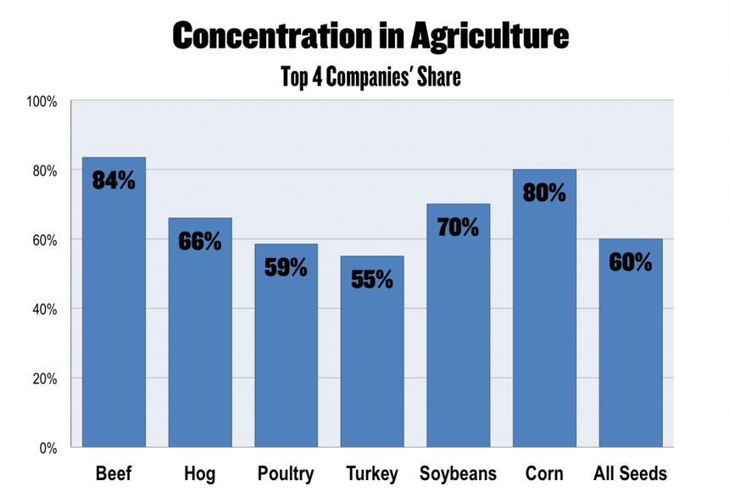
Objective
Does American Agribusiness demonstrate an oligopoly?
If so, how and what are the consequences?

Slide 4
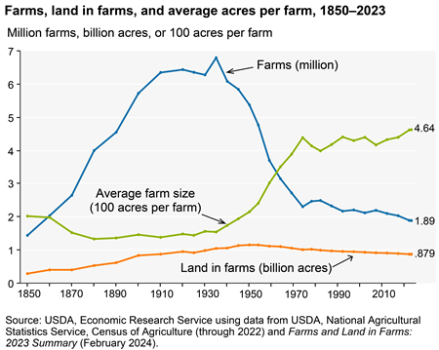
Scope
Historical Data: 1930-2024
Establish trends
Provide context
Emphasis on 21st century and recent developments

Slide 5

Methodology
Data Utilization:
Quantitative
Gov’t & Econ Data, NGO Reports, etc.
Qualitative
Academic Articles, Policy Papers, News
Goal: Clear themes + Statistics =
Fact Based Conclusion
Limitations:
Many key financials and c-suite market outlooks are privatized or confidential

Slide 6
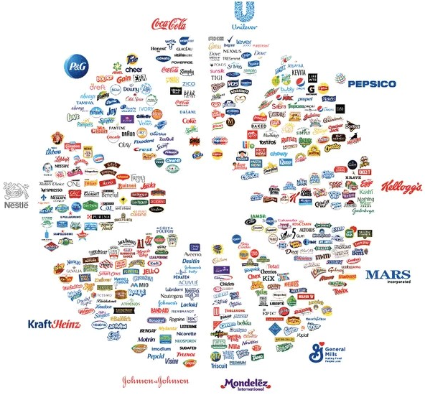
Findings
Agribusiness = Consolidated
Farmers in negative feedback loop
Few Corporations dominate markets
M&A sustains anti-competitive oligopoly
Proven anti-competitive behaviors
Causing Economic Challenges for Farmers

Slide 7
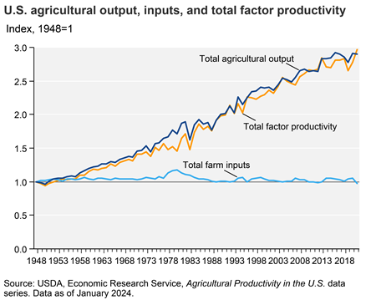
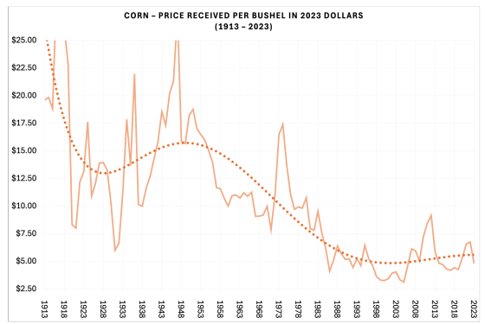
Economic Challenges for Farmers
After WWI, farms were pushed to industrialize and consolidated because:
non-farm employment opportunities
growing productivity
Crop prices experienced growing supply, thus substantially decreasing crop prices

Slide 8
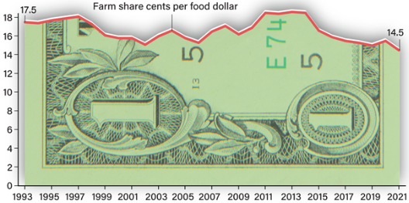
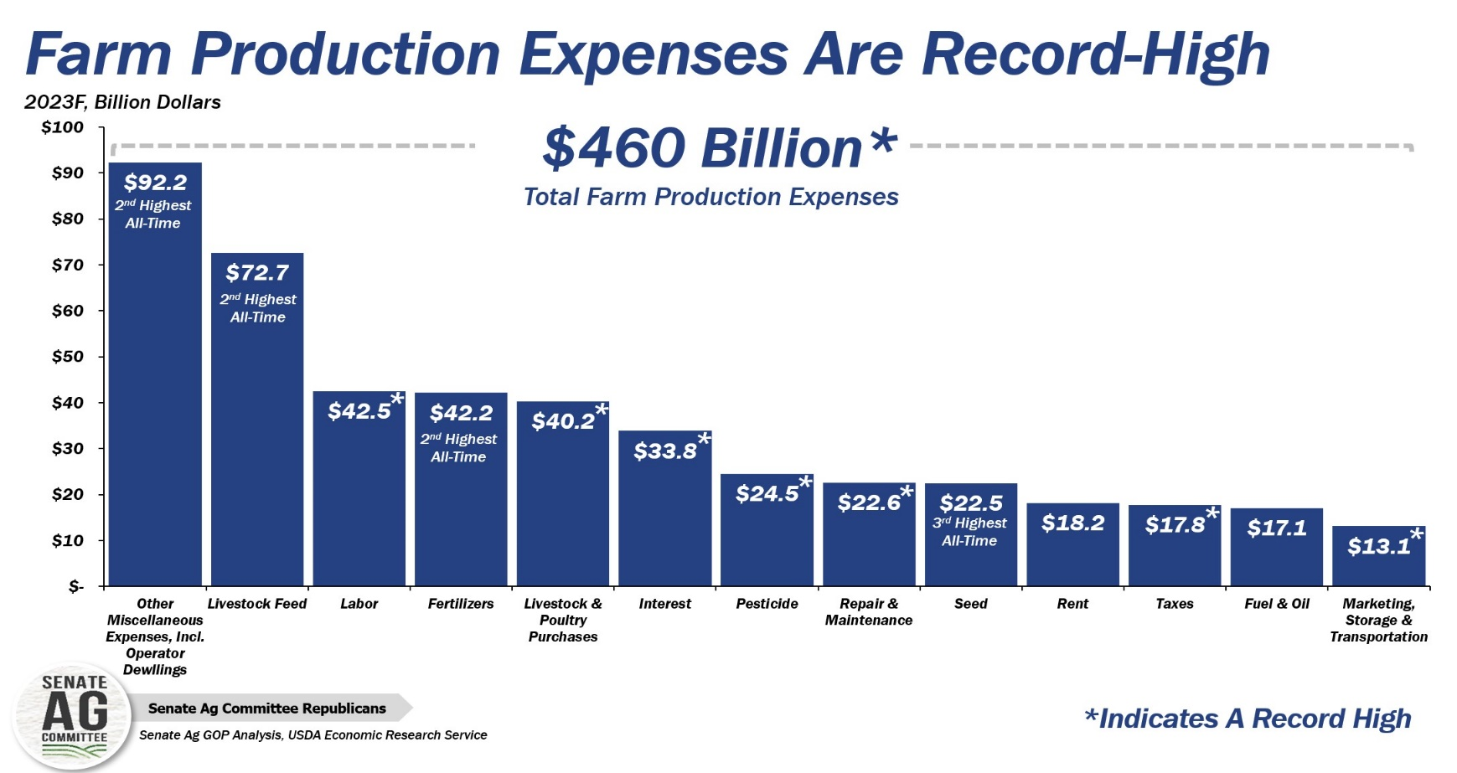
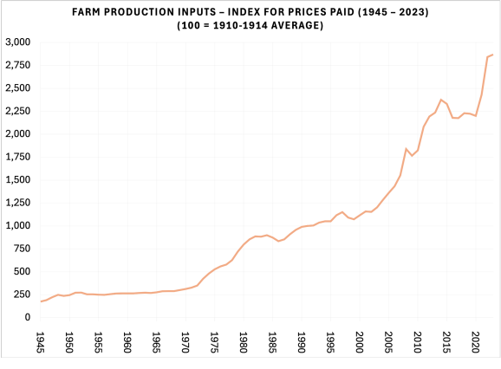
Economic Challenges for Farmers (Continued)
Despite this increase in output per farmer, they have experienced a decline in rev. share.
Despite this, prices paid on inputs have continuously grown, reaching all time highs

Slide 9
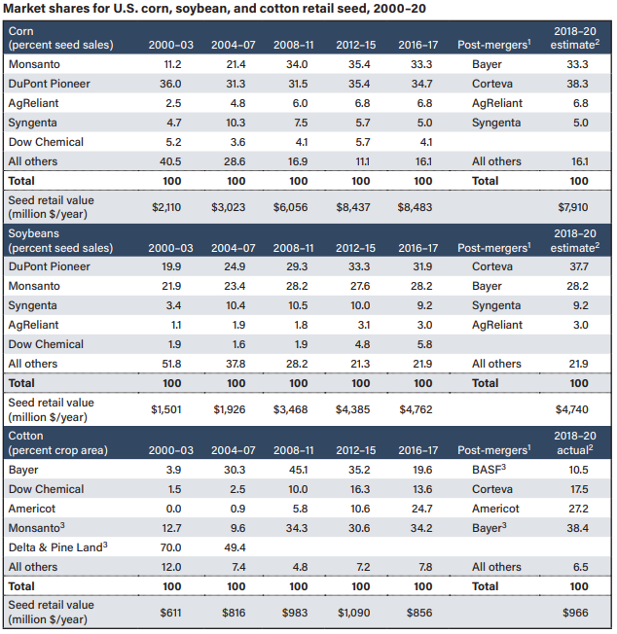
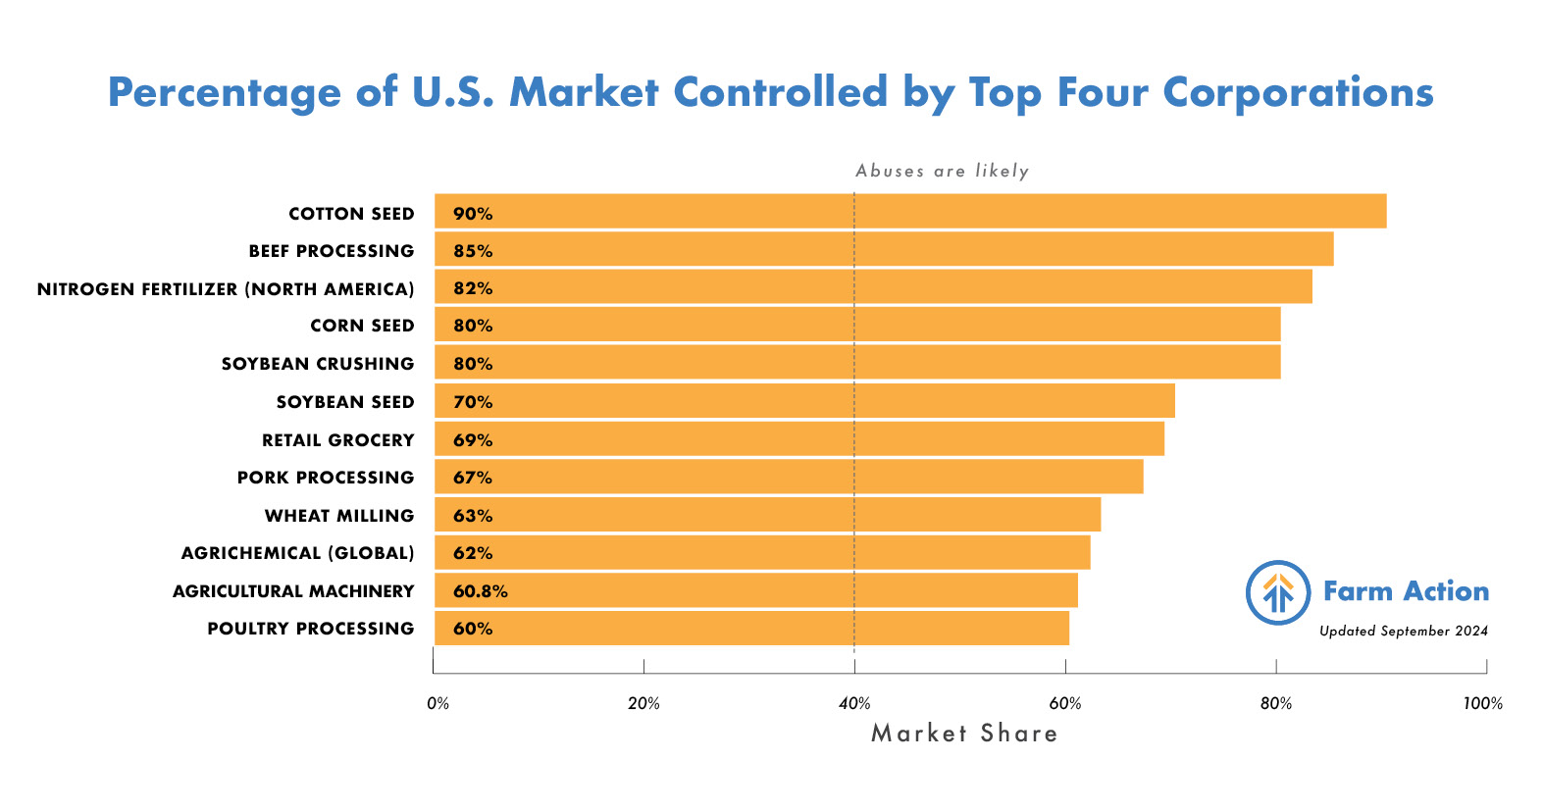
Midstream Consolidation
Midstream = Distributors + Farming Inputs
Market concentration growing to where top four corps dominate their markets. Despite this, mergers continue to maintain oligopolies

Slide 10
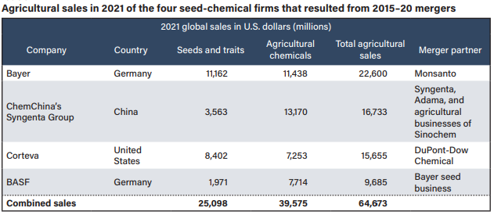
Midstream Consolidation
Many of these companies operate globally and dominate prices
Anti-Competitive behavior: poultry distributors (60% mkt ownership) recently charged for price-fixing
While farmers struggle, these agribusinesses increasingly expand operating margin and net profits.
This allows for further M&A to maintain and grow their market power

Slide 11
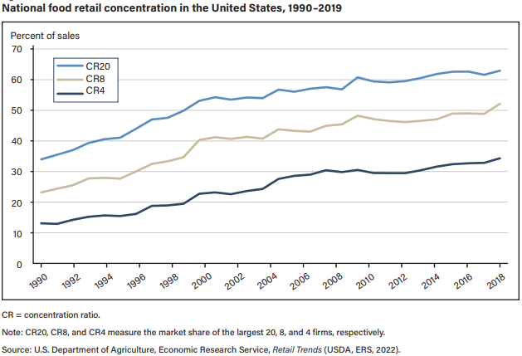
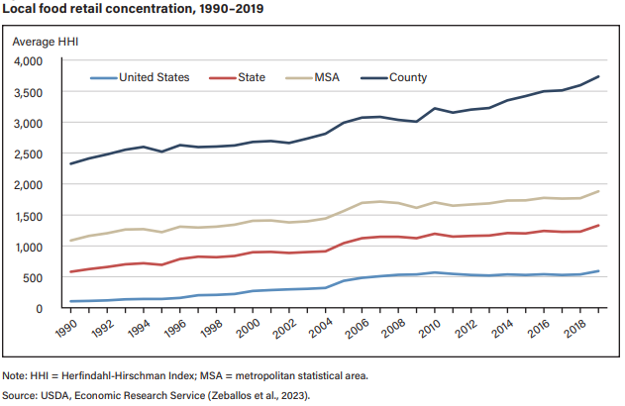
Downstream Consolidation
While the corporates supplying and distributing products centralize, the wholesalers and retailers themselves are also becoming further consolidated.
Top 8 retailers in the US own 50% of sales and growing
On the county level, the average Herfindahl-Hirschman Index (HHI) is 3,600, about 2.5x the “normal score”

Slide 12
Effects & Ethics
Impact:
Record High Farmer Debt
Suicide rates above other occupations
Destroying social fabric of rural cities
Environment & Health:
Industrialization of farming = worse quality, pollution, and biodiversity issues
Pesticide use increases pest resistance = feedback loop of farmer dependence
93% of Americans have Glyphosate in their urine a “probable human Carcinogen” (WHO)
Ethics:
America is a bastion of capitalism that other nations follow and should maintain proper economic control by regulating anti-competitive markets

Slide 13
Conclusion
Conclusion: Midstream and Downstream food corporations’ abuse anti-competitive systems, ultimately damaging the ability for farmers to excel economically and socially
Farming is now a profession characterized by:
High Debt
Environmental Degradation
Low Income Potential
Regulation:
Recent legislative movements have failed to properly hold agribusiness accountable
Subsidies should be better targeted to supporting farmers
Sustainable practices should be incentivized

Slide 14
Citations
Chart of the day: Pepsi does not just sell Pepsi. Crews Bank & Trust. (2024, October 1). https://www.crews.bank/blog/pepsi-does-not-just-sell-pepsi
EcoWatch. (2022, November 29). Glyphosate found in urine of 93 percent of Americans tested. https://www.ecowatch.com/glyphosate-found-in-urine-of-93-percent-of-americans-tested-1891146755.html
Farm household income estimates. USDA ERS - Farm Household Income Estimates. (n.d.). https://www.ers.usda.gov/topics/farm-economy/farm-household-well-being/farm-household-income-estimates/
Farm share of U.S. Food Dollar reached historic low in 2021. USDA ERS - Chart Detail. (n.d.). https://www.ers.usda.gov/data-products/chart-gallery/gallery/chart-detail/?chartId=105281
Farming and farm income. USDA ERS - Farming and Farm Income. (n.d.). https://www.ers.usda.gov/data-products/ag-and-food-statistics-charting-the-essentials/farming-and-farm-income/
Foodrevolutionnetwork. (2024, November 12). Why small family farms are disappearing - and what it means for our World. Food Revolution Network. https://foodrevolution.org/blog/small-family-farms/
Guardian News and Media. (2021, July 14). Revealed: The true extent of America’s food monopolies, and who pays the price. The Guardian. https://www.theguardian.com/environment/ng-interactive/2021/jul/14/food-monopoly-meals-profits-data-investigation
“kings over the necessaries of life”: (n.d.-a). https://farmaction.us/wp-content/uploads/2024/09/Kings-Over-the-Necessaries-of-Life-Monopolization-and-the-Elimination-of-Competition-in-Americas-Agriculture-System_Farm-Action.pdf
“kings over the necessaries of life”: Monopolization and the elimination of competition in America’s agriculture system. Farm Action. (2024, September 26). https://farmaction.us/kings-over-the-necessaries-of-life-monopolization-and-the-elimination-of-competition-in-americas-agriculture-system/
On the farm: Debt is up and income is not. (n.d.-b). https://www.farmprogress.com/commentary/on-the-farm-debt-is-up-and-income-is-not
Revisiting farm production expenses: The United States Senate Committee on Agriculture, Nutrition & Forestry. [2023-05-09] Revisiting Farm Production Expenses | Senate Committee On... (2023, May 9). https://www.agriculture.senate.gov/newsroom/minority-blog/revisiting-farm-production-expenses
Rural behavioral and mental health still overlooked. Center For Rural Affairs - Building a Better Rural Future. (2016, May 25). https://www.cfra.org/blog/rural-behavioral-and-mental-health-still-overlooked
Thompson, M., & Saltzman, M. (2024, January 14). How rural communities are tackling a suicide and depression crisis among farmers. PBS. https://www.pbs.org/newshour/show/how-rural-communities-are-tackling-a-suicide-and-depression-crisis-among-farmers
USDA. (n.d.-c). https://www.ers.usda.gov/webdocs/publications 106795/eib-256.pdf?v=7330.5.

Slide 15

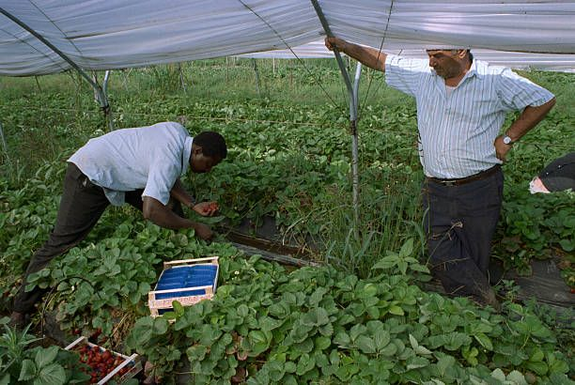
Thank You!
Any Questions?

